Slide 1
Understanding suicide
A Complicated Grief
Bruce Rickard

Slide 2


Anticipatory grief
Anticipatory grief is the ‘beginning of the end’ in our minds.
Anticipatory grief may manifest itself as a strange feeling in the pit of the stomach or an ache in the heart.

Slide 3

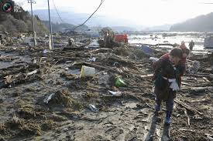
A traumatic aftermath
Suicide can shatter the things you take for granted about yourself, your relationships, and your world.
Jack Jordan, Ph.D.,
Suicide carries in its aftermath a level of confusion and devastation that is, for the most part, beyond description.
Psychologist Kay Redfield Jamison

Slide 4


A personal journey
Your grief is like your fingerprint, unique and personal to you.
(Irving & Thompson)
Grief is not sequential and it is certainly not predictable. Grief doesn’t always move in a forward direction.

Slide 5


Survivors of suicide
Survivors may grieve more intensely, and for longer periods, than people mourning other types of loss.
What defines a survivor of suicide is not the degree of closeness to the individual but the intensity of the reaction to the loss. Smolin & Guinan

Slide 6


Avoiding the pitfalls
He who conceals his grief finds no remedy for it. Old Turkish Proverb
The awkwardness of grief tempts us to hide from the truth.
Randy Christian

Slide 7
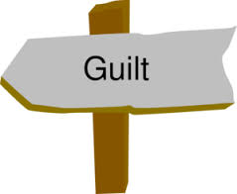

Common emotions
Unless it is dealt with carefully, guilt can be one of the most destructive emotions.
Dr Sheila Clark
Anger is a natural reaction to the unfairness of loss, a projection of one’s own sadness.

Slide 8

Questions that won’t go away
Asking the questions honestly and courageously gives us the best chance of coping with the grief that follows a suicide.
There are many mysteries surrounding suicide:
Why did this happen?
What could I have done to prevent it?
Who’s to blame?

Slide 9

What not to say
“Stop feeling sorry for yourself”
“Life goes on”
“Time heals all wounds”
“Everything happens for a reason”
I know exactly how you feel”
“They've gone to a better place”

Slide 10

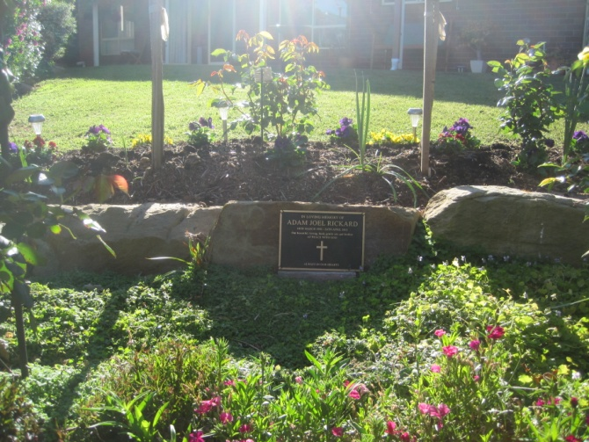
Memories & memorials
Embracing our memories can be a very slow and, at times, painful process that occurs in small steps.
Alan Wolfelt
Memorials are a practical way of perpetuating the memory of your loved one.

Slide 11
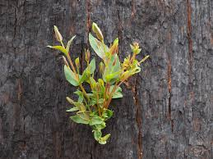

Embracing the new normal
To assimilate a suicide into life is to absorb the pain and to incorporate the death into other aspects of life.
Tom Smith
The suicide of a loved one irrevocably transforms us. Our world explodes and you are never the same.
Carla Fine

Slide 12


The necessity of hope
Hope will enable you to overcome the pain of your loss, the stigma of your shame, and the paralysing power of fear.
Dutch Sheets
There is this hope, the promise that something meaningful will result out of all the pain

Slide 13


Relationship with deceased
Death doesn’t erase a relationship; it simply places it in a different context.
People are not really dead and gone until there is no-one left to remember them.
Gillian Bouras

Slide 14

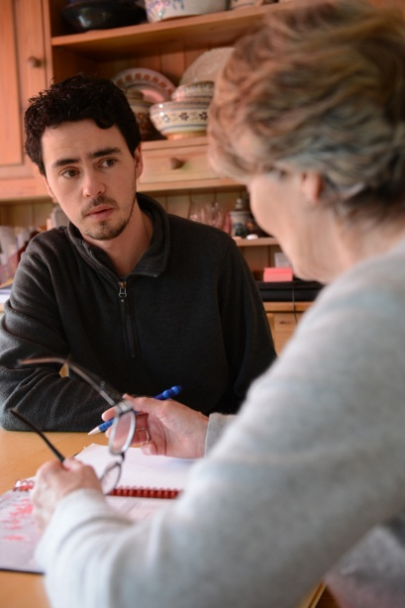
Reaching out for help
Suicide is a topic that is defined by silence – we hide it, we deny it, we’re afraid to talk about it.
Myers & Fine
Many people are at a loss about what to do when their friend or relative has lost a loved one to suicide.

Slide 15

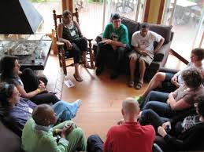
The role of support groups
When we meet someone else who has ‘been there’, it makes our personal chaos and isolated secrecy seem a little less frightening.
Carla Fine
Support groups for suicide survivors are an invaluable therapeutic, curative process.
Smolin & Guinan

Slide 16

Resources
Elisabeth Kubler-Ross & David Kessler, On Grief and Grieving
(New York, NY 10020: Simon & Schuster 2007)
Ann Smolin & John Guinan, Healing After the Suicide of a Loved One
(New York, NY 10020: Simon & Schuster 1993)
C. S. Lewis, A Grief Observed
(New York, NY 10020: HarperCollins 1994)
Alan D. Wolfelt, Ph.D., The Wilderness of Suicide Grief
(Colorado, 80526: Companion Press 2010)
David B. Biebel & Suzanne L. Foster, Finding Your Way after the
Suicide of Someone You Love
(Michigan, 49530: Zondervan 2005)
Tom Smith, The Unique Grief of Suicide
(Bloomington, IN 47403: iUniverse 2013)
Michael F. Myers, M.D. & Carla Fine, Touched by Suicide
(New York, NY 10014: Gotham Books 2006)

