Slide 1
UNDERSTANDING SUICIDE
A Workshop
Presented by Bruce Rickard

Slide 2
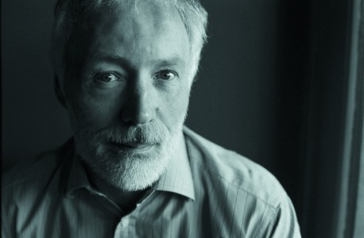
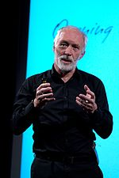
Patrick McGorry, former Australian of the Year (2010) and a leading advocate for mental health issues
Suicide is a silent killer whose footprints are actively concealed by a frightened and often judgmental society.

Slide 3
UNDERSTANDING SUICIDE
A Brief Overview

Slide 4

Touched by suicide
The ripple effect:
Each suicide leaves behind on average six to ten survivors - husbands, wives, parents, children, siblings, other close friends or family members.

Slide 5
Defining suicide
What is suicide?
Suicide refers to death as a result of self-inflicted harm where the intention was to die.
(Response Ability Website)
Suicide is any self-injurious act intended to end one’s life which results in death. It is defined as death by self-inflicted, intentional injury.
(Counselling Connections Website)

Slide 6

The search for answers
Finding answers:
Understanding the death of a friend or loved one to suicide is like trying to solve a jigsaw puzzle. Sadly, some of the pieces will never be found.

Slide 7

Candidates for suicide
Suicide knows no boundaries.
No matter what a person’s social or economic status, religion, education, IQ, race, gender or age, suicide strikes within them all.
(Beverly Cobain & Jean Larch ‘Dying to Be Free’)

Slide 8
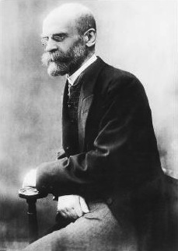
Pioneer thinker
Emile Durkheim (1858 – 1917)
French Sociologist
Asserted that suicide did not take place in isolation, but was instead a consequence of the interplay between the individual and societal pressures and influences.

Slide 9

The suicidal mind
The Suicidal Mind.
Attempting to decipher precisely
the thoughts of the suicide victim
is much like trying to understand a
foreign language by eavesdropping
on a conversation.
Psychache – psychological pain. The hurt , anguish, or ache that takes hold in the mind.
The Suicidal Mind Edwin S. Shneidman

Slide 10


The suicidal mind
Ambivalence
A person at risk can have reasons for living and reasons for dying simultaneously.
Tunnel Vision
Suicide is viewed as the only solution to ending one’s pain.

Slide 11
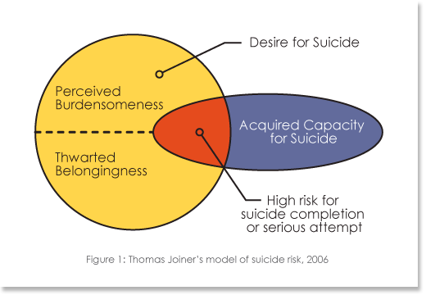
Identifying suicide risk
“The Interpersonal Theory of Suicide”

Slide 12

Perceived burdensomeness
The view that one’s existence
burdens family, friends,
and society.
“I make things worse for the people in my life.”
LIABILITY
“I am useless.”
SELF-HATRED

Slide 13

Thwarted belongingness
The feeling that one is alienated from
others others and not an integral part
circle of of a family, friends,
or other valued group.
  Loneliness – too few social connections
  Absence of reciprocally caring relationships

Slide 14

Acquired capacity for suicide
“Humans are not wired for self-destruction.”
Self preservation is the protection of oneself
from harm or destruction.
It is also the innate desire to stay alive.
An acquired capacity for suicide involves a lowered fear of death
and an increased physical pain tolerance.

Slide 15
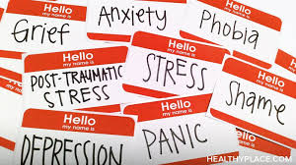
Risk factors
Suicide is a complex phenomenon and rarely occurs as the result of a single event.
A combination of individual, relational, community, and societal factors contribute to the risk of suicide.
The vast majority of people who die by suicide (i.e., approximately 95%)
suffer from mental disorders.

Slide 16
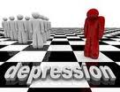
Warning signs
People who are depressed and exhibit the following symptoms are at a particularly high risk of suicide.
Extreme hopelessness
Quitting activities that were previously important
Noticeable weight loss – looking unhealthy
General withdrawal from social discourse
Putting affairs in order
Agitation
Insomnia
Talking about suicide; prior history of attempts

Slide 17
Common misconceptions about suicide
“Most ‘normal people don’t think of taking their life.”
“Most suicides occur without warning.”
“People who talk about suicide won't really do it.”
“If a person is determined to kill themselves,
nothing is going to stop them.”
“People who suicide are people who were
unwilling to seek help.”
“If someone reveals their suicide plan, you should
not break their confidentiality.”

Slide 18
Understanding suicide
Further Reading:
Thomas Joiner, Why People Die By Suicide
(Cambridge, MA: Harvard University Press, 2005)
Kay Redfield Jamison, Night Falls Fast
(New York: Alfred A. Knopf, 1999)
Beverly Cobain & Jean Larch, Dying to Be Free
(Minnesota: Hazelden Foundation, 2006)
Edwin Shneidman, The Suicidal Mind
(New York: Oxford University Press, 1996)
Thomas Joiner, Myth About Suicide
(Cambridge, MA: Harvard University Press, 2010)

