Slide 1
Hope is for the Living
Bruce Rickard
hopefortomorrow.info

Slide 2
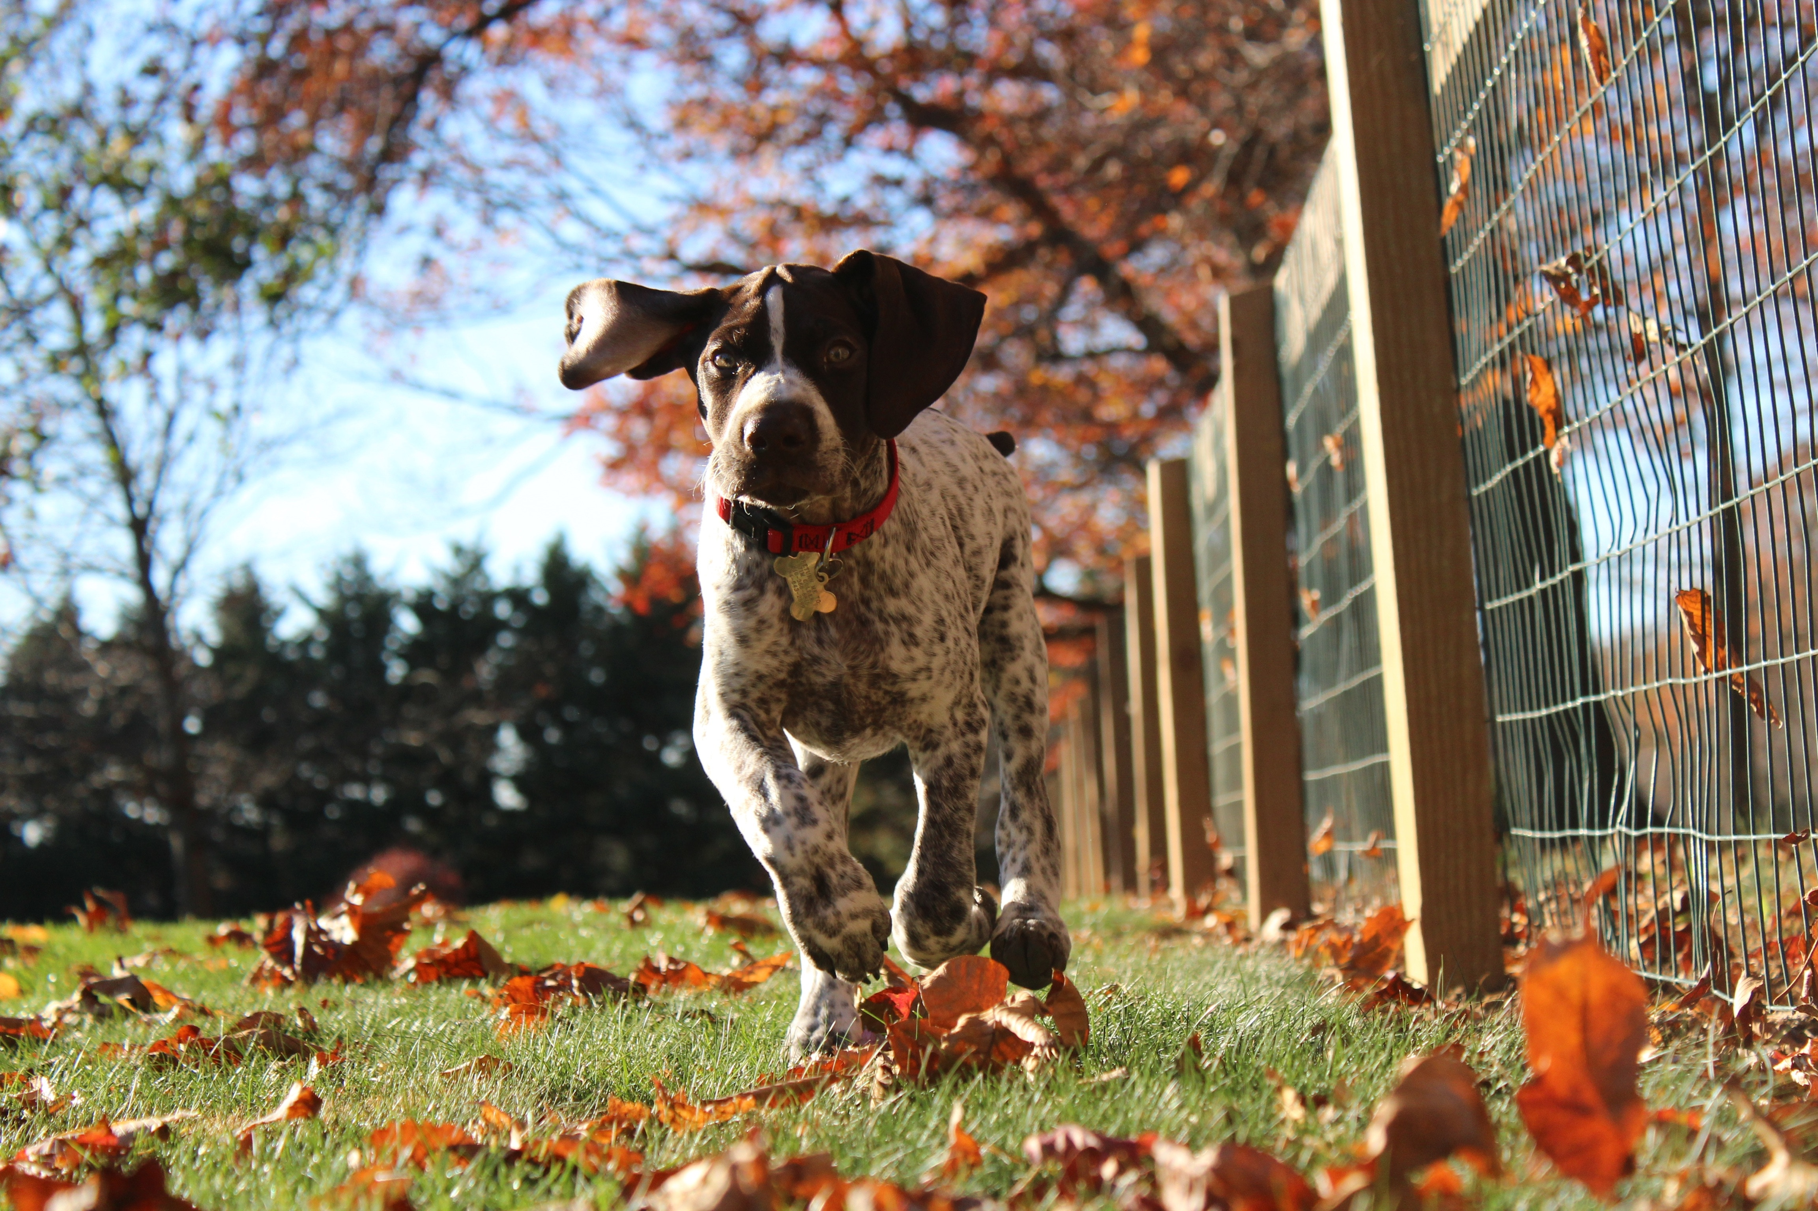
Hope is for the Living
                “But anyone still alive has hope; even a live dog is better off than a dead lion.” Ecclesiastes 9:4

Slide 3
Without hope life is sterile, unfruitful. Without it dreams won’t be conceived; destinies won’t be realised.
Dutch Sheets

Slide 4

Hope is not fragile but it can slip from our grasp. Given the uncertainty of life, it is vital we hold on to hope.

Slide 5
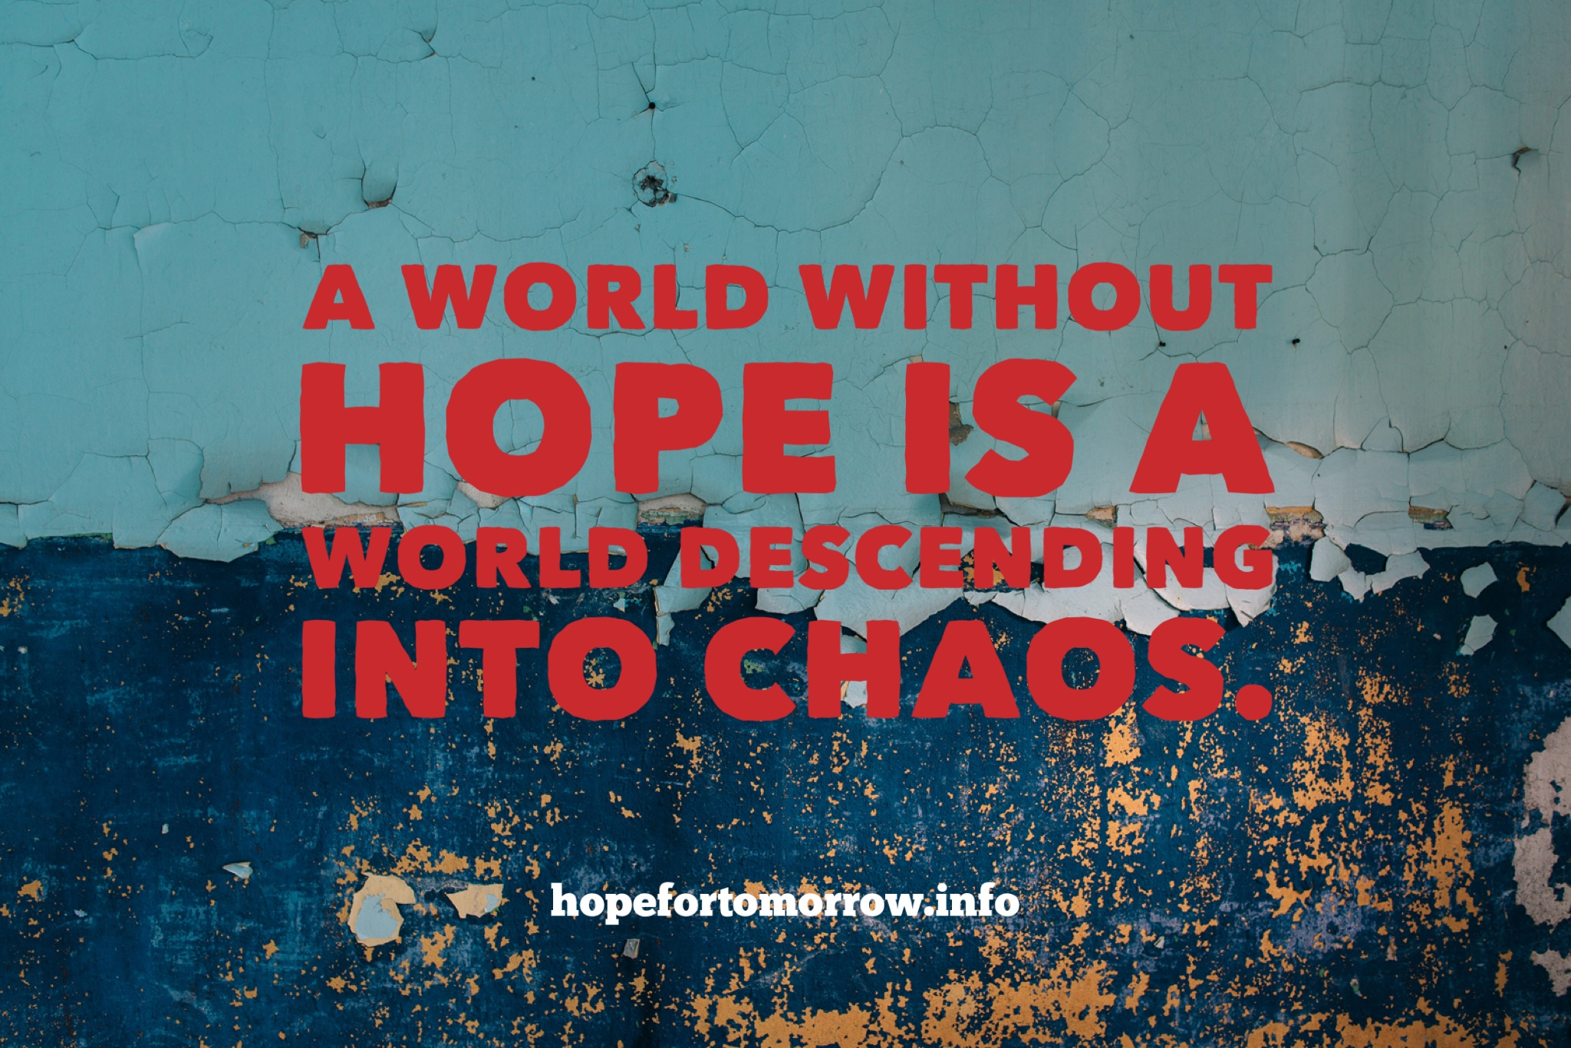

Slide 6
Hopelessness and self-doubt are often the catalyst for suicidal thoughts.

Slide 7
There are two strategies
we can use
to encourage hope.

Slide 8
1. Telling Stories

Slide 9

Storytelling shapes how we think about life.
If we are to live hopeful lives we need to hear stories that inspire courage and determination.

Slide 10
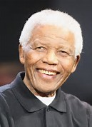
An example:
Nelson Mandela
A hope of a better future - a nation free of racial prejudice - sustained Nelson Mandela during 27 years of imprisonment.

Slide 11
Narratives of hope empower the faint-hearted.

Slide 12
2. Teaching Principles

Slide 13
Hope is not an emotion. It is a way of thinking or a cognitive process.
C. R. Snyder

Slide 14
Hope is a combination of setting goals, having the tenacity and perseverance to pursue them, and believing in our own abilities.

Slide 15
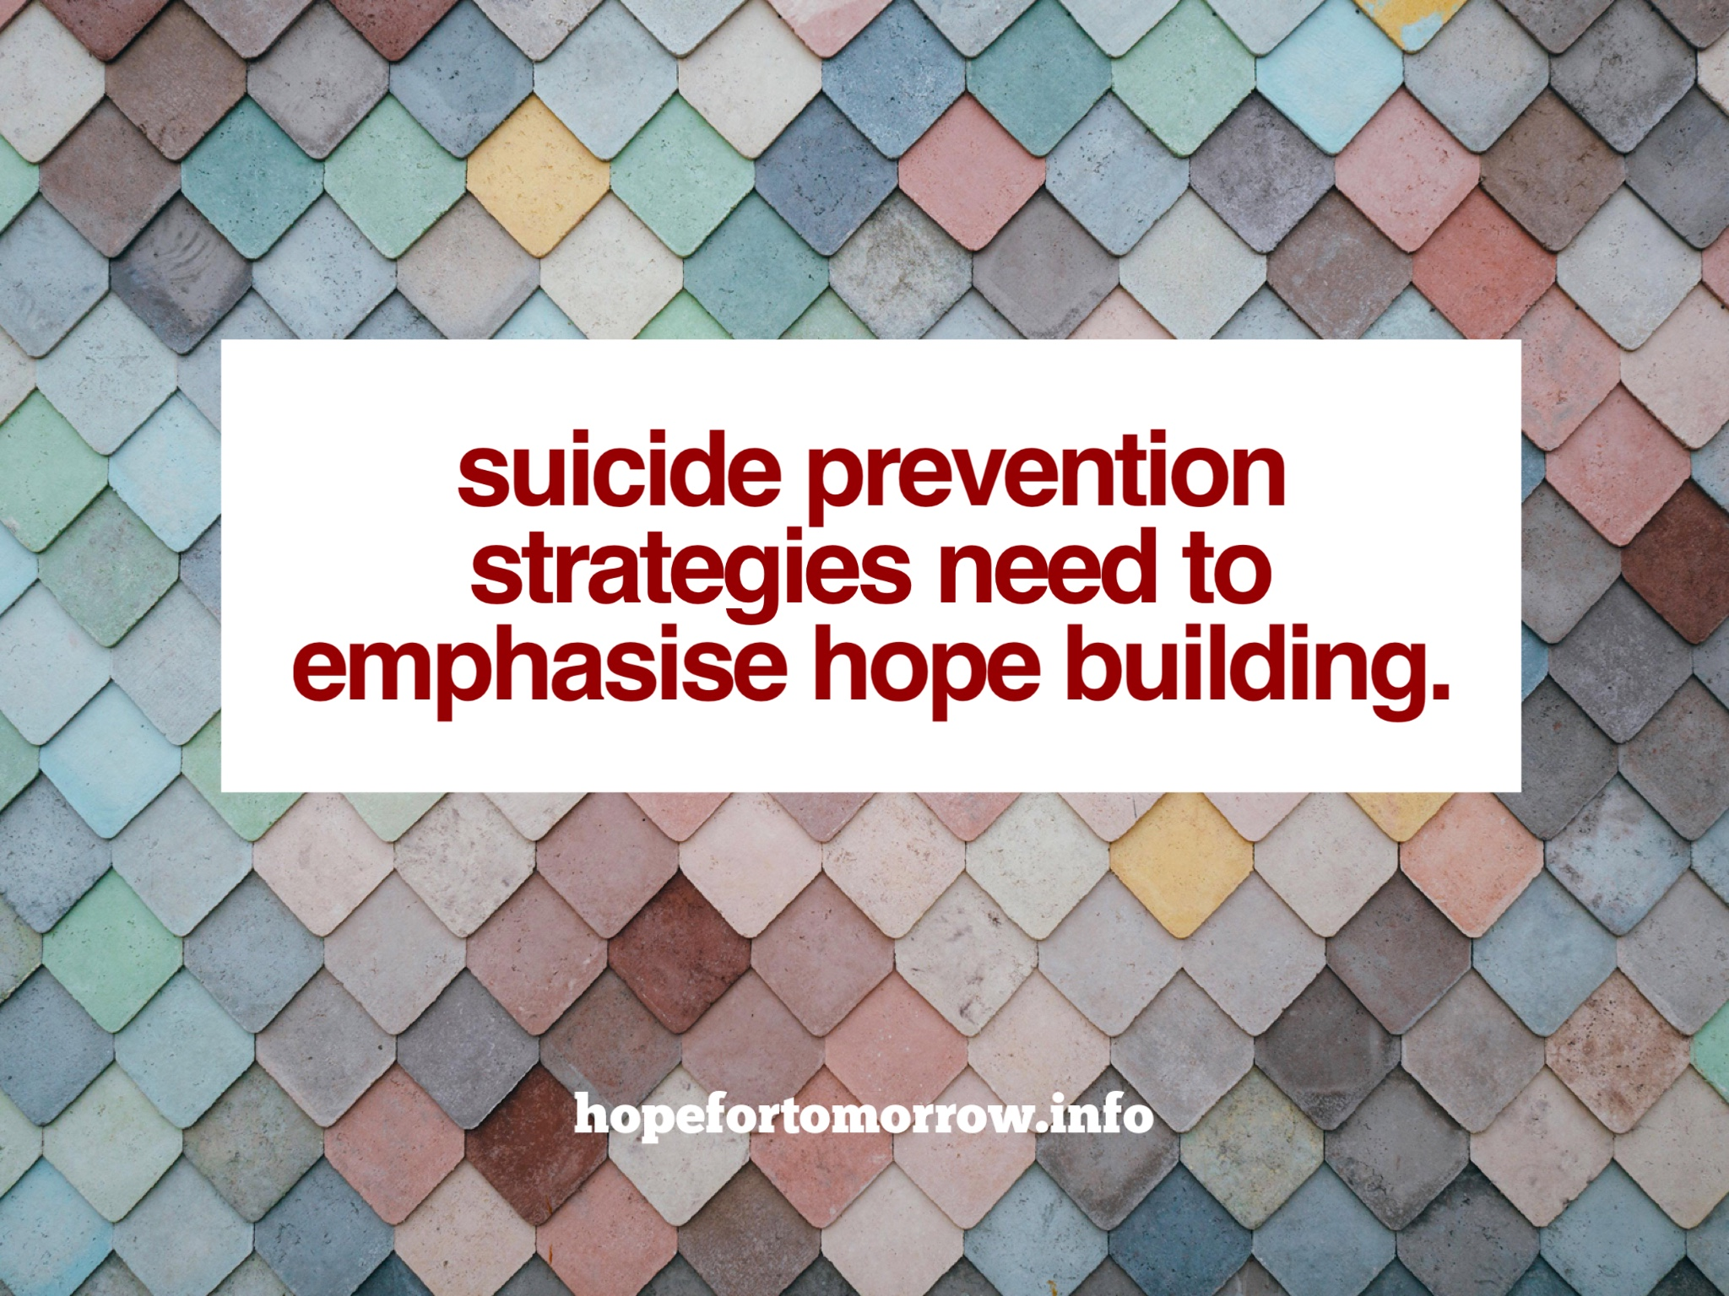

Slide 16

Hope provides the foundation for resilience. Hope guarantees our future.

Slide 17
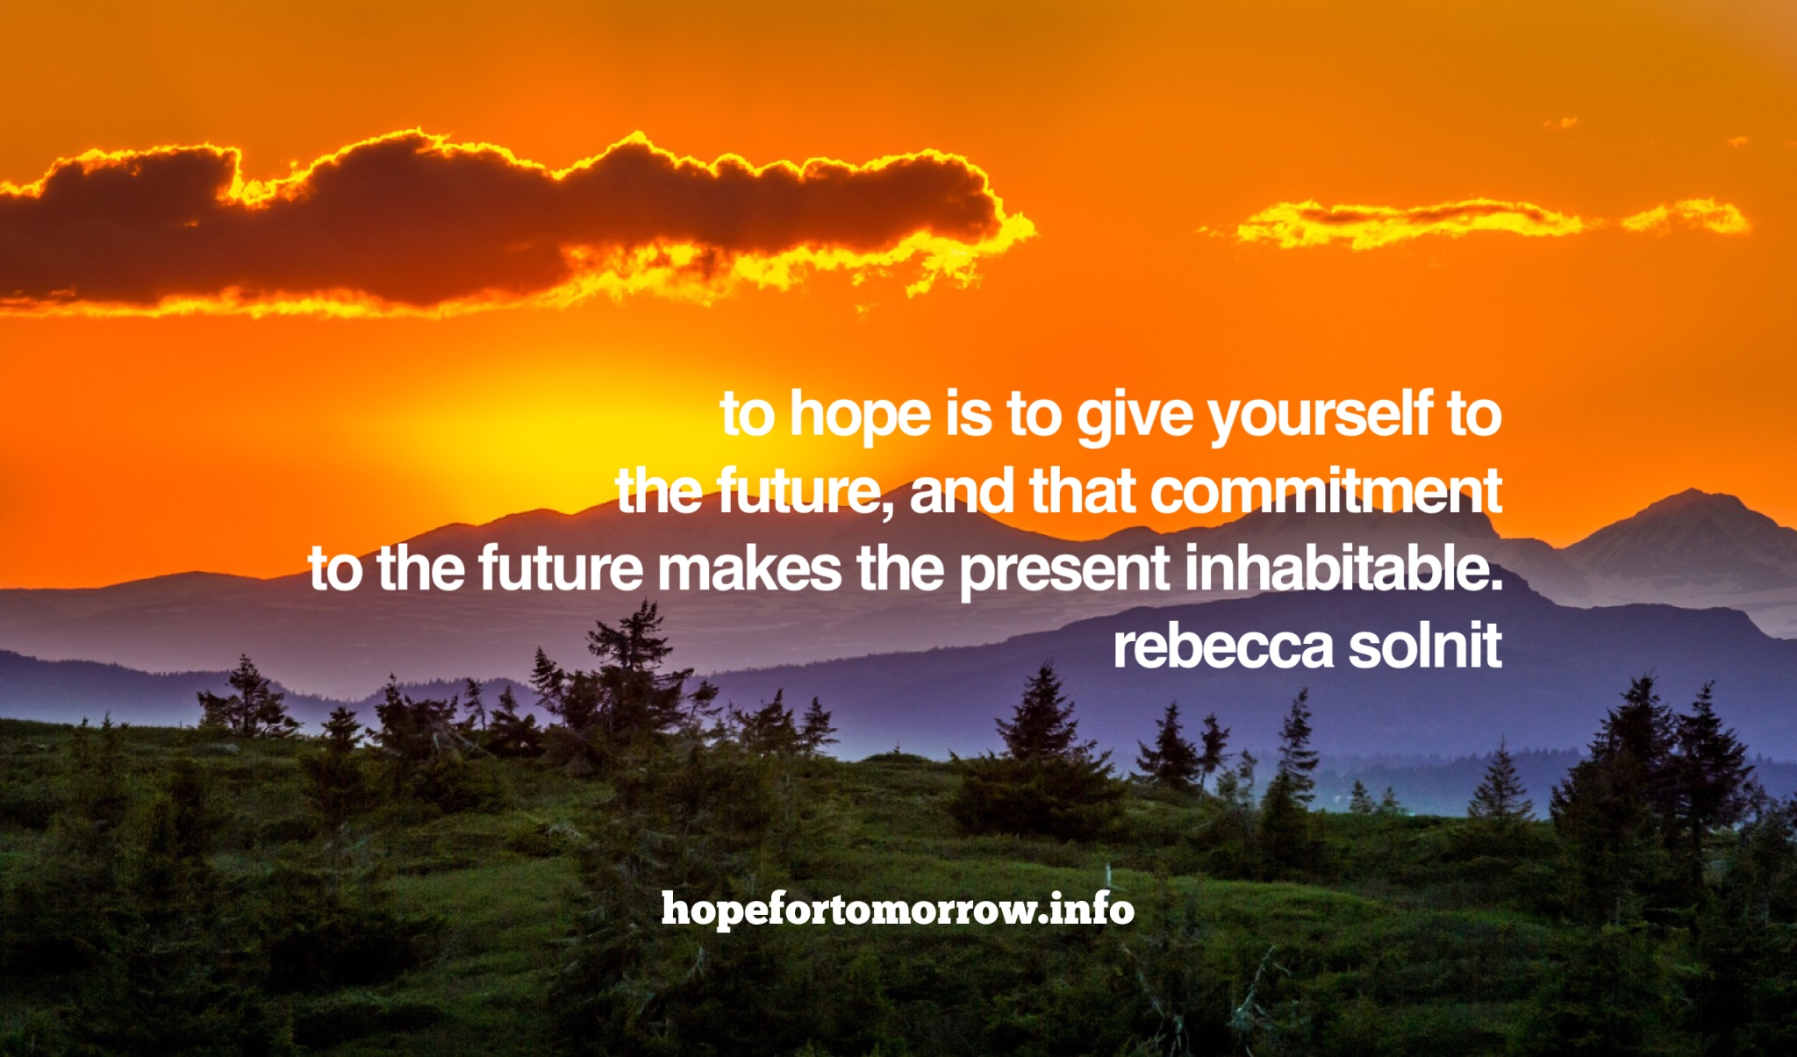

Slide 18
Hope is for the Living
http://hopefortomorrow.info/2017/10/hope-is-for-the-living/

